Slide 1
CS 366 Intro to Computer Security
Dr. Stella Sun
EECS
University of Tennessee
Fall 2022

Slide 2
Today’s Class
Web security
- Session hijacking and cross-site attacks
Refresher: cookies

Slide 3
Cookies

Slide 4
HTTP is stateless
The lifetime of an HTTP session is typically:
- Client connects to server (TCP)
- Client issues a request (HTTP)
- Server sends a response (HTTP)
- Client issues a request for something in the response (HTTP)
- …repeat… (HTTP)
- Client disconnects (TCP)
HTTP has no means of noting “oh this is the same client from that previous request”
With this alone, you’d have to log in at every page load

Slide 5
HTTP is stateless
“Stateless” means HTTP does not store state
If state is desired, it is implemented as a layer on top of HTTP

Slide 6
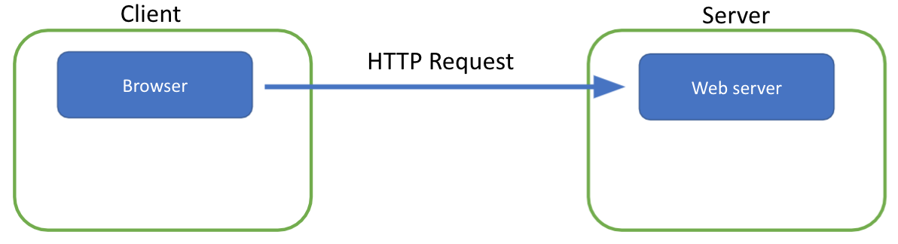
Maintaining State across HTTP Sessions

Slide 7
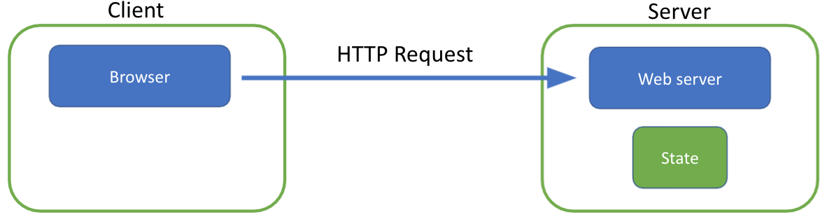
Maintaining State across HTTP Sessions
Server processing results in intermediate state

Slide 8
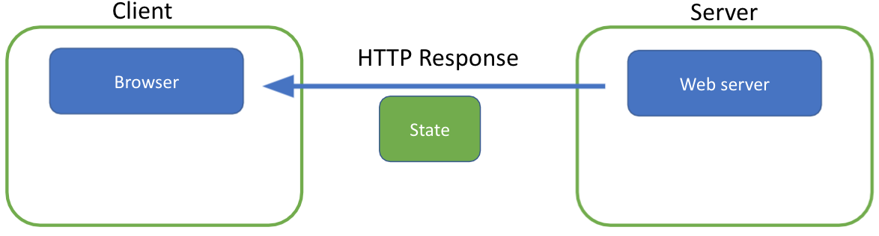
Maintaining State across HTTP Sessions
Server processing results in intermediate state
Sends the state to client in hidden fields

Slide 9
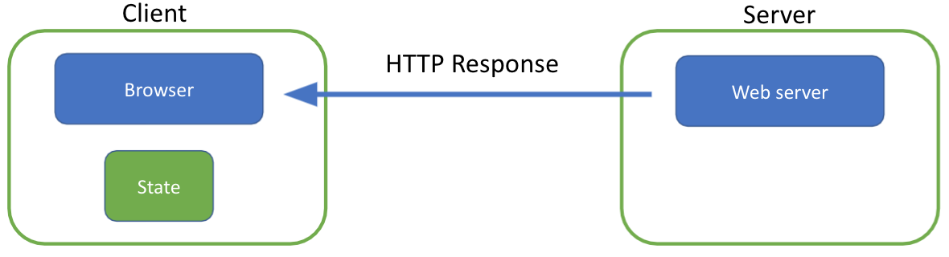
Maintaining State across HTTP Sessions
Server processing results in intermediate state
Sends the state to client in hidden fields

Slide 10
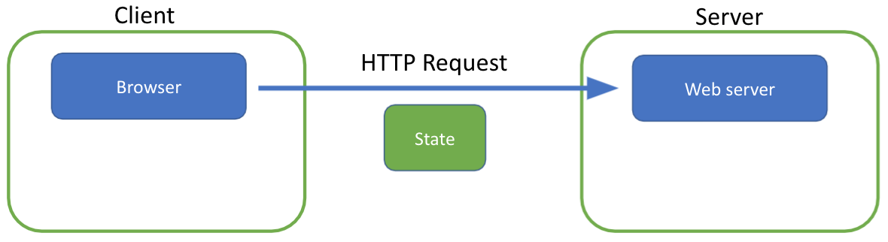
Maintaining State across HTTP Sessions
Server processing results in intermediate state
Sends the state to client in hidden fields
Client returns the state in subsequent requests

Slide 11
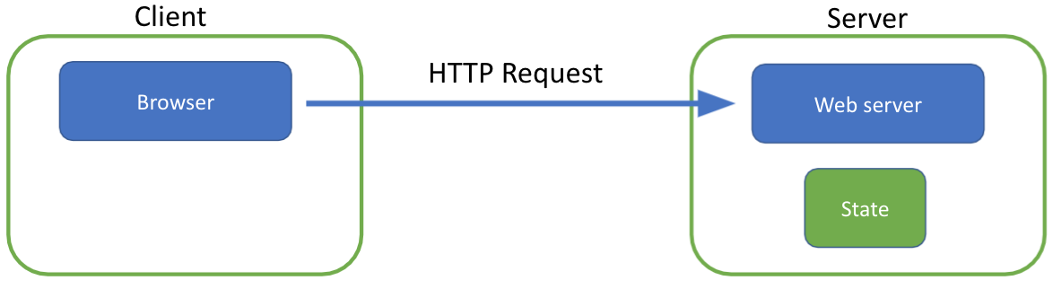
Maintaining State across HTTP Sessions
Server processing results in intermediate state
Sends the state to client in hidden fields
Client returns the state in subsequent requests

Slide 12
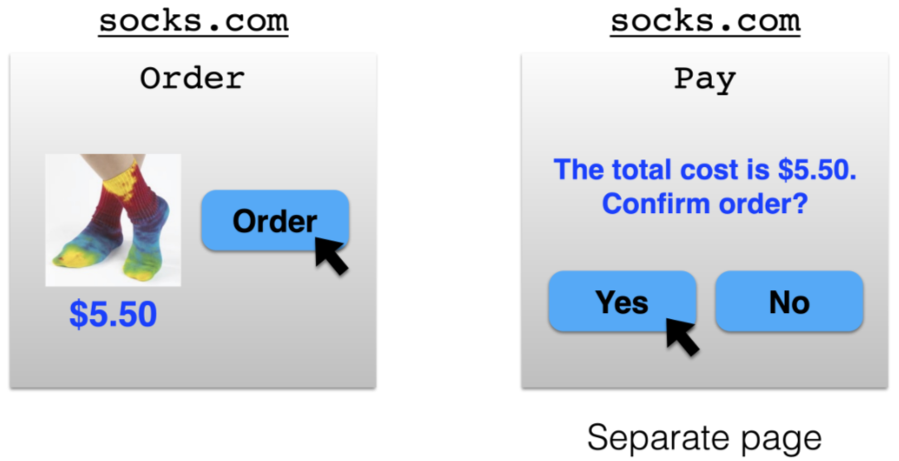
Example: Online Ordering

Slide 13
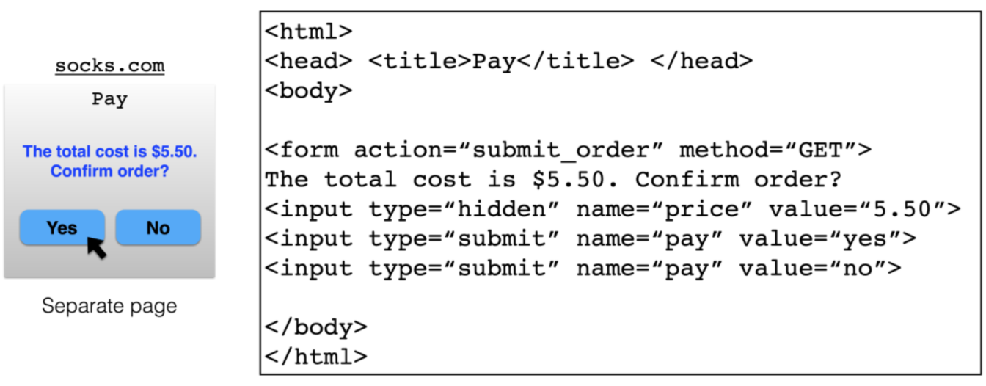
What’s presented to the user

Slide 14
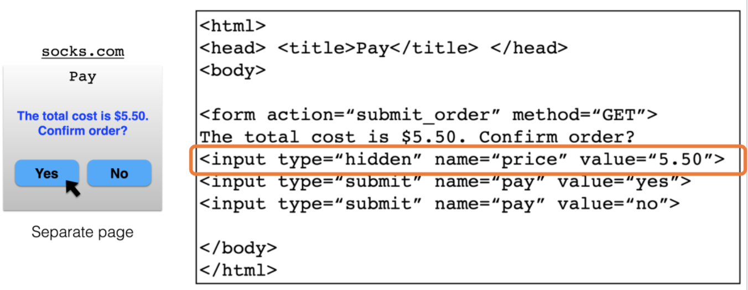
What’s Presented to the User
www.socks.com/…?price=5.5&pay=yes

Slide 15
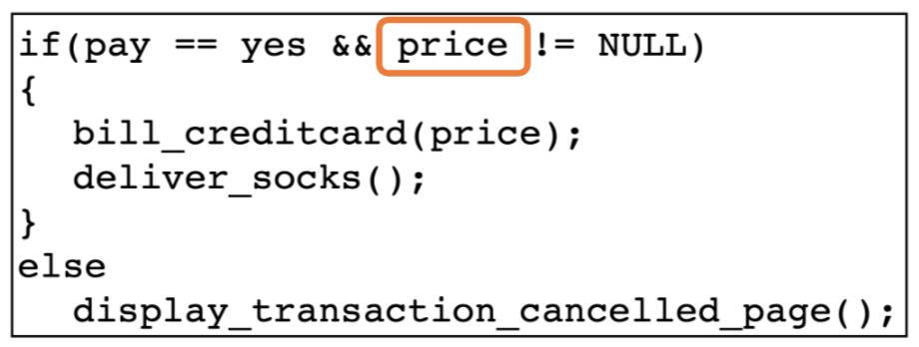
The Corresponding Backend Processing

Slide 16
What’s Presented to the User

Slide 17
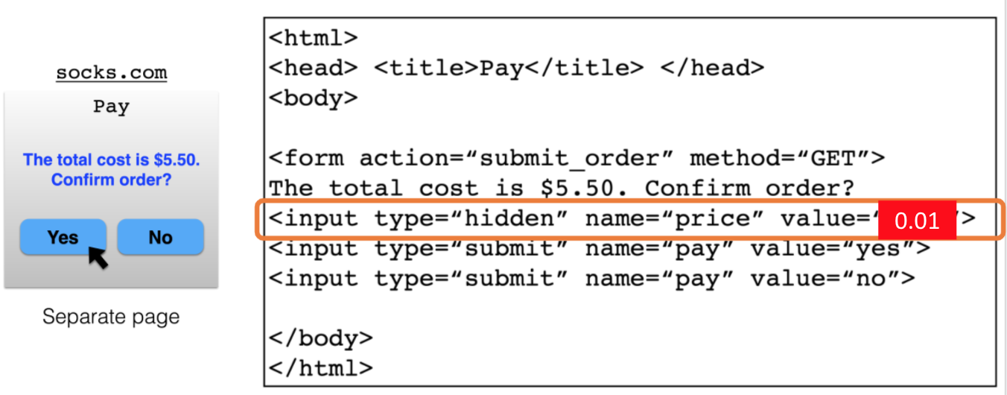
What’s Presented to the User

Slide 18
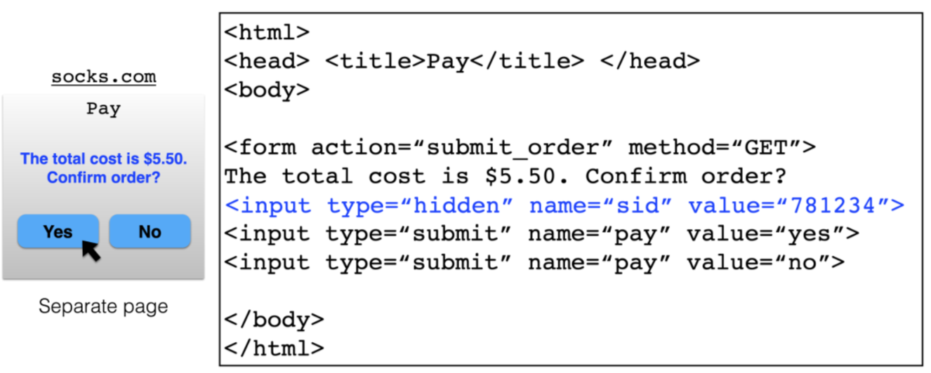
Minimizing Trust in the Client

Slide 19
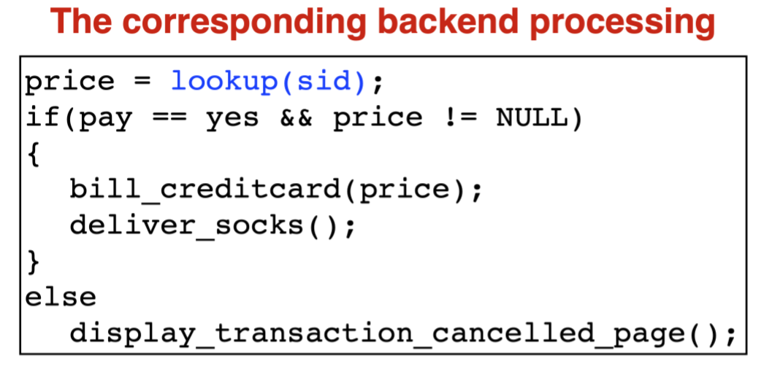
Minimizing Trust in the Client

Slide 20
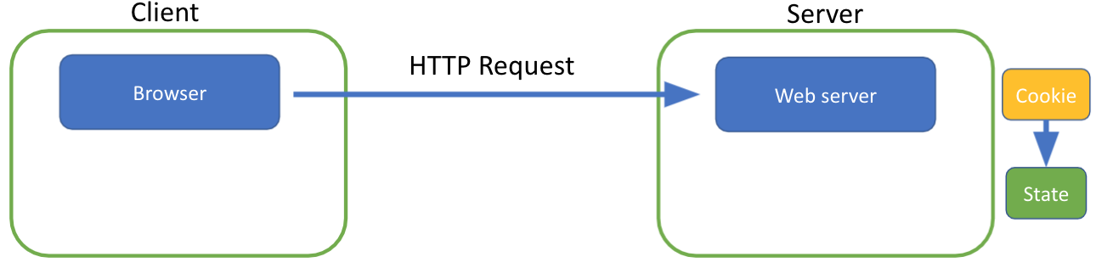
Maintaining State with Cookies
Server stores state, indexes it with a cookie

Slide 21
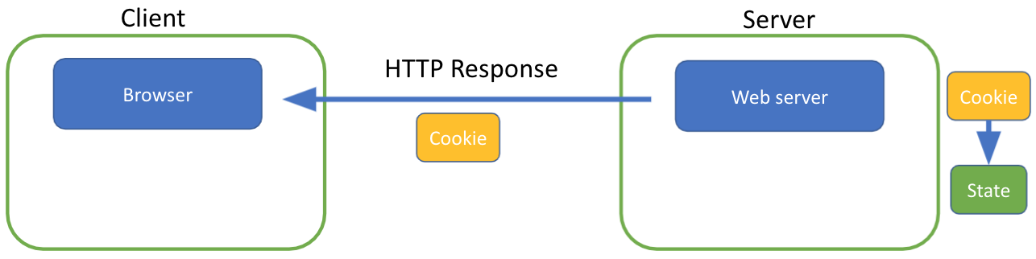
Maintaining State with Cookies
Server stores state, indexes it with a cookie
Sends the cookie to client

Slide 22
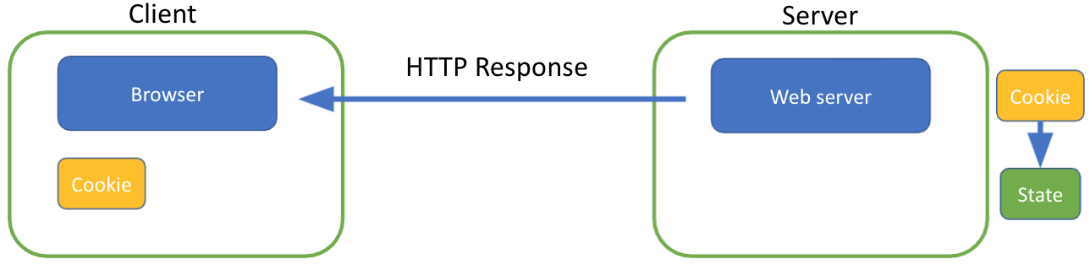
Maintaining State with Cookies
Server stores state, indexes it with a cookie
Sends the cookie to client
Client stores the cookie and returns it with subsequent requests to the same server

Slide 23
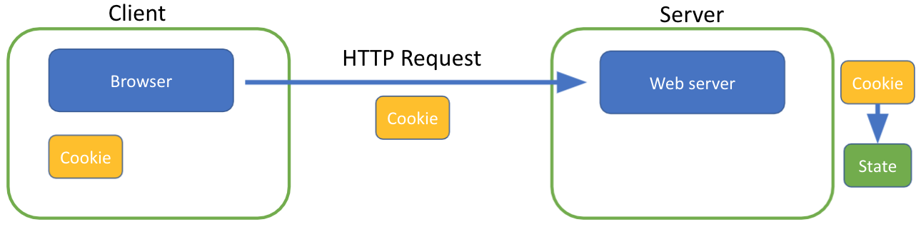
Maintaining State with Cookies
Server stores state, indexes it with a cookie
Sends the cookie to client
Client stores the cookie and returns it with subsequent requests to the same server

Slide 24
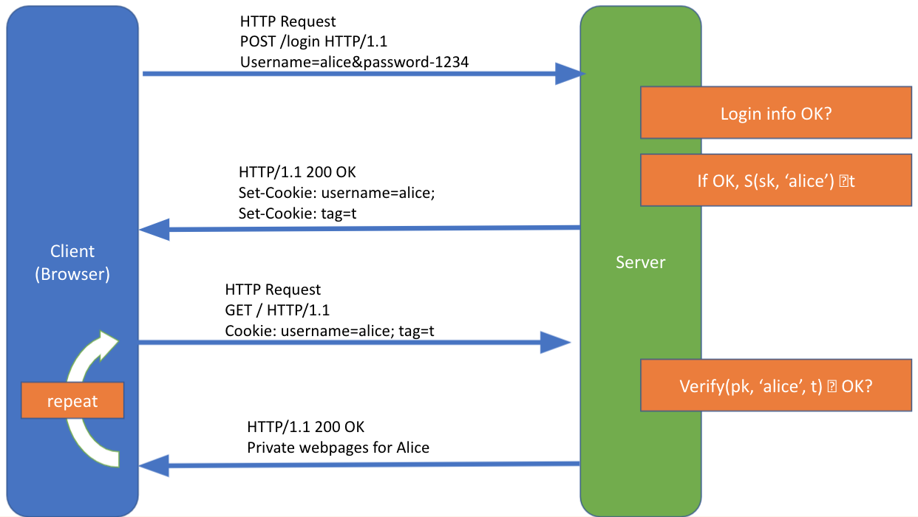

Slide 25
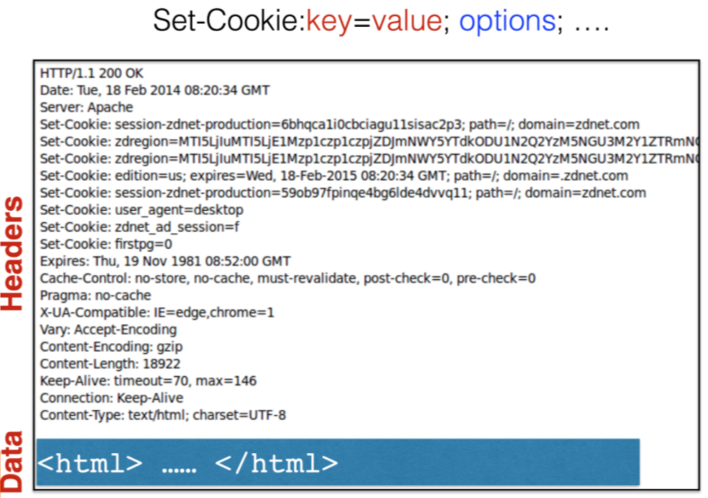
Cookies are Key-Value Pairs

Slide 26
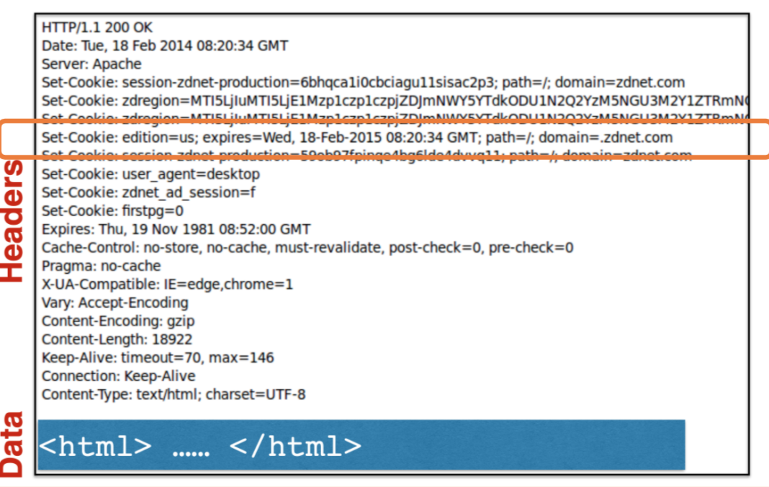

Slide 27
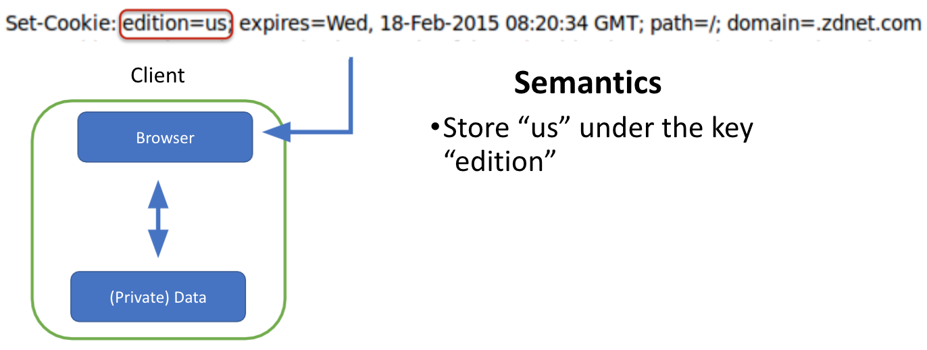
Cookies

Slide 28
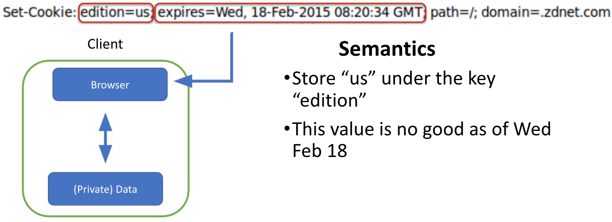
Cookies

Slide 29
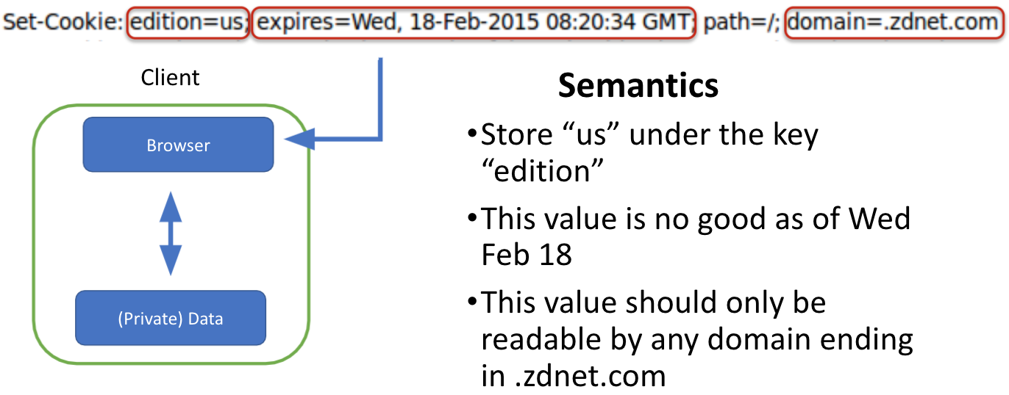
Cookies

Slide 30
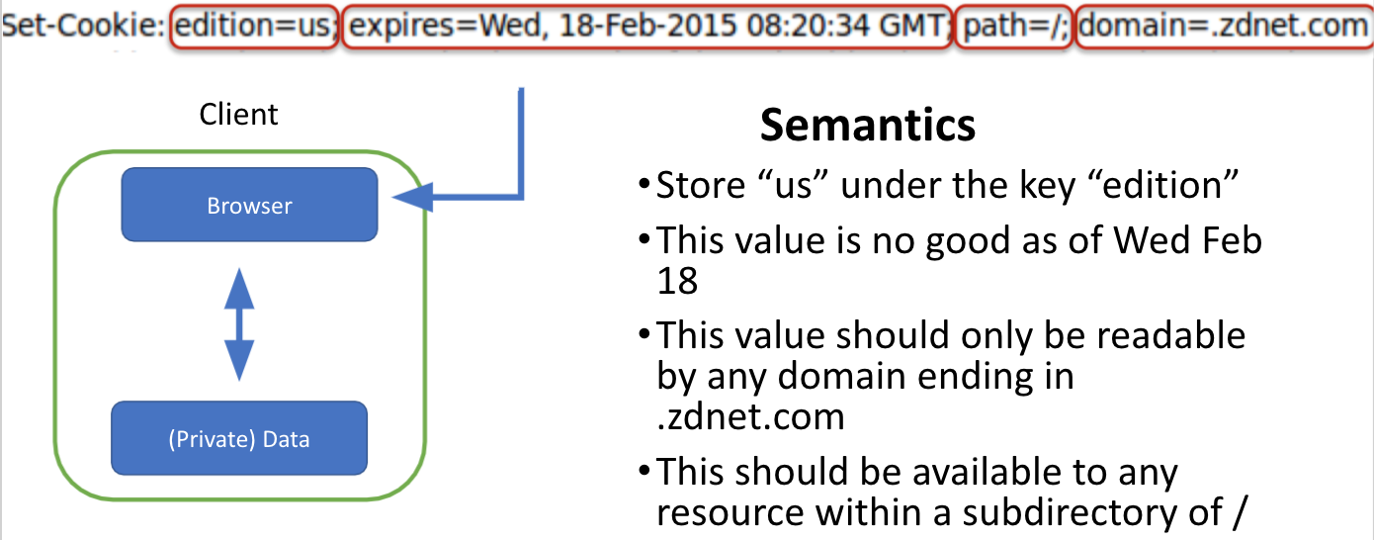
Cookies

Slide 31
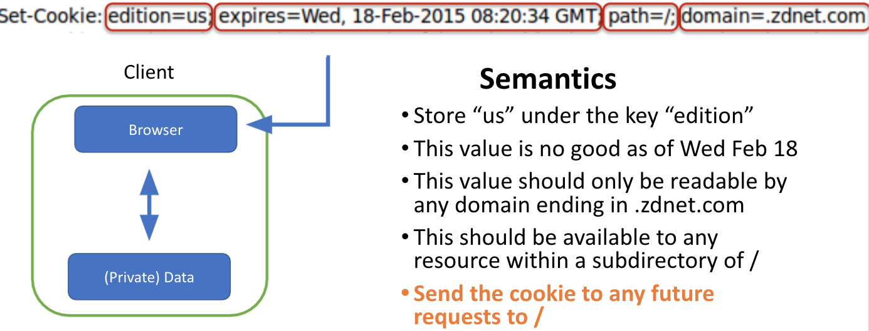
Cookies

Slide 32
How Long Can Cookies Last?
Sites can set Expires to a very far-future date and the cookie will last until a user clears it
When Expires not specified, last for current browser session

Slide 33
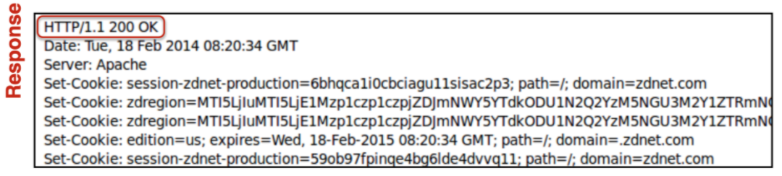
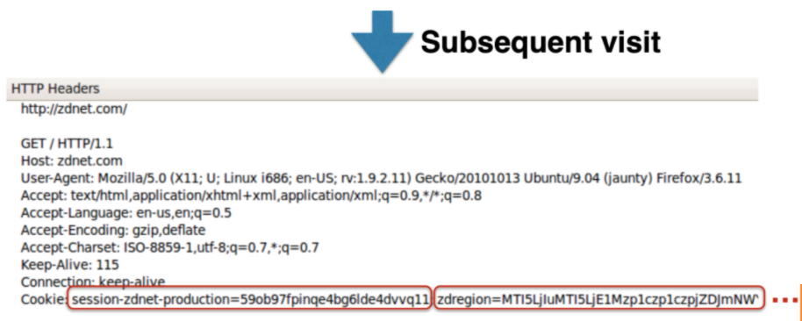
Requests with Cookies

Slide 34
Why Use Cookies?
Personalization
- let an anonymous user customize your site
- store front choice, etc., in the cookie
Tracking users
- advertisers want to know your behavior
- ideally build a profile across different websites

Slide 35
Session Hijacking

Slide 36
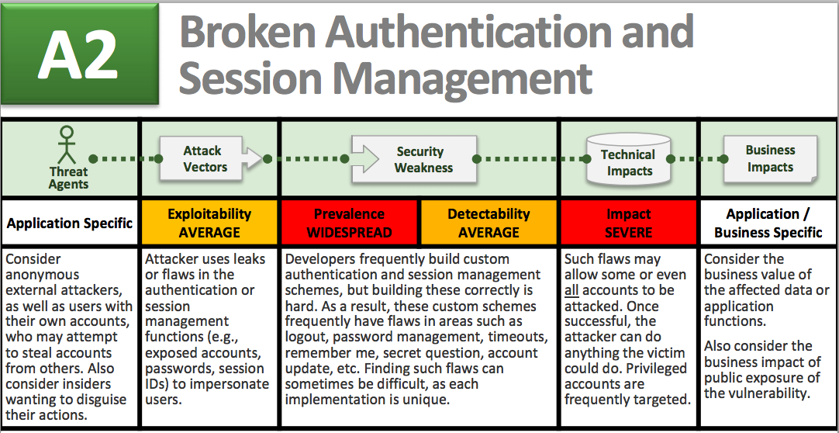
Session hijacking

Slide 37
What is session hijacking
Attacker stealing a user session to impersonate the user to the server
How can an attacker steal a user session?
- sessions are usually persisted by cookies
- sending cookies over HTTP is a very bad idea
- attacker can grab the cookie and use it in his HTTP request to fool the server

Slide 38
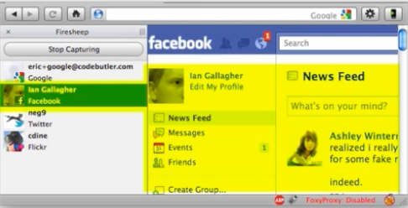
Firesheep
Attacker can install Firesheep and sit in a café with open WiFi connection
Firesheep will sniff cookies people’s browsers send to the web server over HTTP
It made a big impact for websites to migrate to HTTPS

Slide 39
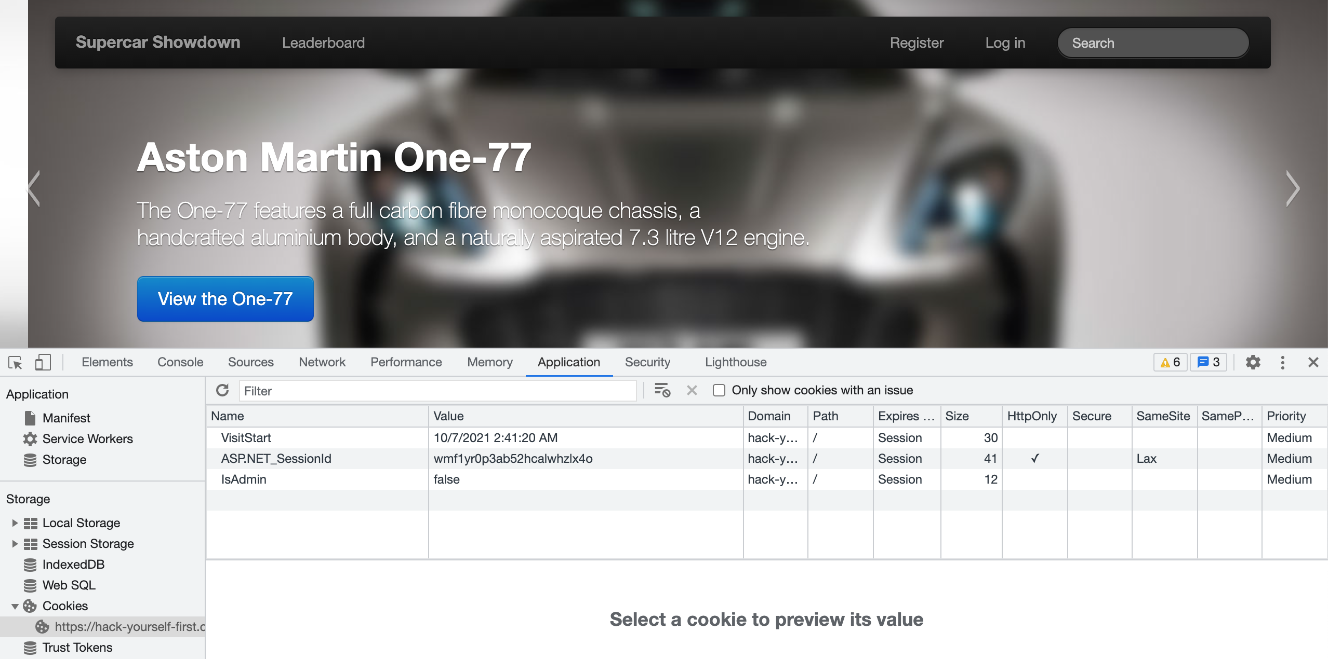
Persisting sessions via cookie
A simple example

Slide 40
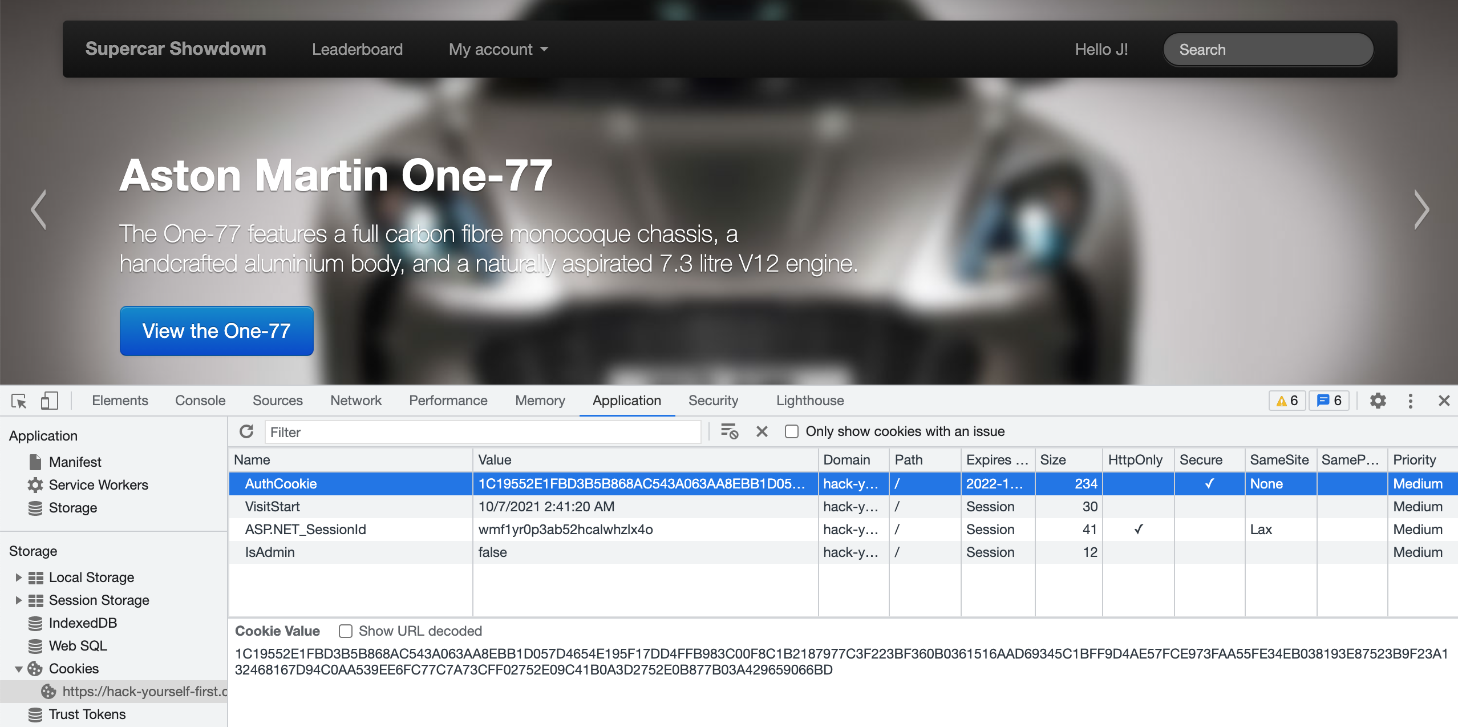
Persisting sessions via cookie
After logged in…

Slide 41
Persisting sessions via cookie
What if I delete the AuthCookie?
- I am no longer logged in
What happens to AuthCookie if I log in again?
- There will be a new AuthCookie
What happens when AuthCookie is sent via HTTP?
- Someone can copy it and impersonate me
What if I open a new tab in the same web browser while logged in?
- I am still logged in
What if I open a new tab in the same browser incognito while logged in?
- I am no longer logged in
What if I open another web browser and go to the website?
- I am no longer logged in

Slide 42
Session hijacking mitigation
User Secure cookie attribute to prevent cookie from being sent over unencrypted HTTP connections (will only be sent over HTTPS)
Set-Cookie: key=value; Secure

Slide 43
Cookie summary
+ Cookies are automatically persisted on each HTTP request
+ Cookies aren’t usually logged in your browser history, the web server log, or any proxy log
+ Cookies can be persisted once the site is left or browser closed
- Cookies can create attack surface, e.g., CSRF, XSS
- Only one active session per browser (not per tab)

